Slide 1
Predicting service use and functioning for people with first episode psychosis in coordinated specialty care
Melanie Wall, Ph.D.
Director, Mental Health Data Science
New York State Psychiatric Institute and Department of Psychiatry at Columbia University
Seminar at the Department of Biomedical Informatics, CUIMC
March 2, 2020

Slide 2


New York State Psychiatric Institute and
Columbia University Department of Psychiatry
Started in 1896, New York State Psychiatric Institute (NYSPI) has been at the forefront of research, training, clinical care, and policy.
Enlightened vision of New York State to establish a research institute devoted to the study of brain disorders that affect mental function and behavior.
Over 90 year partnership with Columbia University Department of Psychiatry
Year after year ranked #1 in research funding from NIH.
In 2019 over 150 investigators with more than $110 million in grants awarded
The goals are to discover how the brain works and what causes normal and abnormal human behavior, to develop new treatments, and to pave the way for preventions and cures for mental illness.

Slide 3
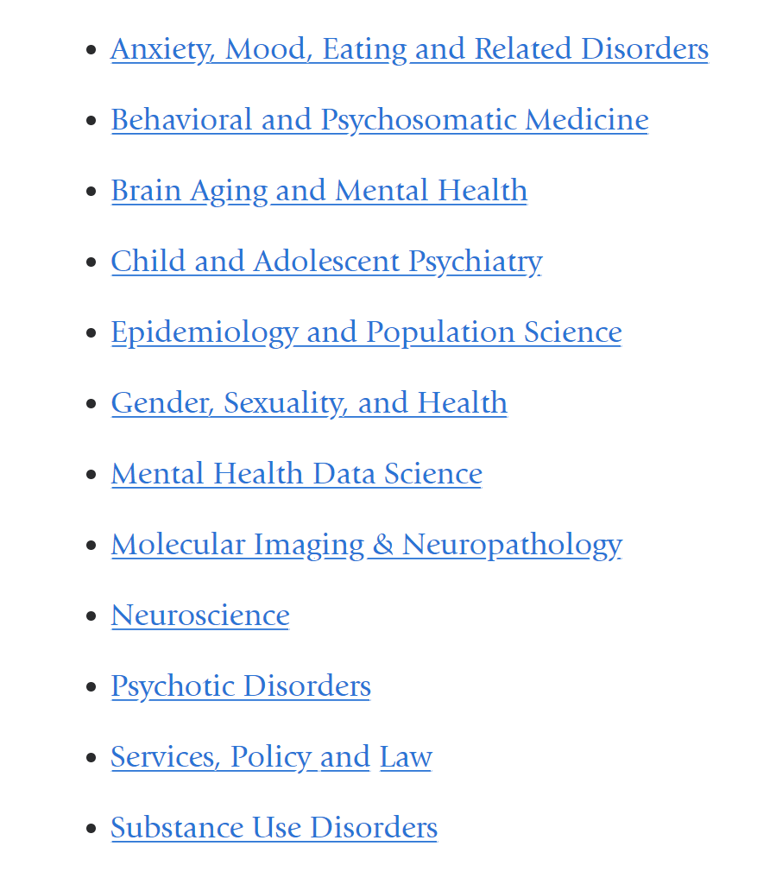
New York State Psychiatric Institute
12 research areas

Slide 4


Slide 5
New York State Psychiatric Institute
12 research areas

Slide 6
Outline
Introduce OnTrack New York (OTNY) services for people with first episode of psychosis
What is a learning health system and what is the role of data science?
What are the problems with current predictive modeling?
An initial case example from OTNY - predicting functioning outcomes from intake information for people with FEP entering OnTrackNY
Where do we need to go next?

Slide 7

OnTrackNY Data Analytics
Partnership between:
Columbia University Mental Health Data Science
Columbia University Mental Health Services - Center for Practice Innovation
Nathan Kline Institute Data Coordinating Center
New York State Office of Mental Health - Office of Performance Measurement and Evaluation
Key contributors to current project
Lisa Dixon
Jennifer Humensky
Jenn Scodes
Cale Basaraba
Caleb Miles
Funding: EPINET R01 MH120597-01 OnTrackNY's Learning Healthcare System

Slide 8
What is First Episode Psychosis (FEP)?
What is Coordinated Specialty Care (CSC)?
What is OnTrack NY?

Slide 9
What is First Episode Psychosis?
Psychosis is a condition that affects the mind, where there has been some loss of contact with reality. Symptoms include delusions (false beliefs) and hallucinations (seeing or hearing things that others do not see or hear). Other symptoms include incoherent or nonsense speech, and behavior that is inappropriate for the situation.
When someone becomes ill in this way it is called a psychotic episode
Psychosis is seen in several psychotic disorders including schizophrenia, schizophrenia spectrum disorders, bipolar disorder.
In people ultimately diagnosed with schizophrenia or bipolar disorder, the first episode of psychosis most commonly occurs between the ages of 15 to 30 years.
Identifying a person with a psychotic disorder early, i.e. soon after their first episode, and connecting them with care can lead to better outcomes
Credit https://www.nimh.nih.gov/health/topics/schizophrenia/raise/what-is-psychosis.shtml
https://www.mentalhealth.com/home/dx/schizophrenia.html#diagnosis

Slide 10
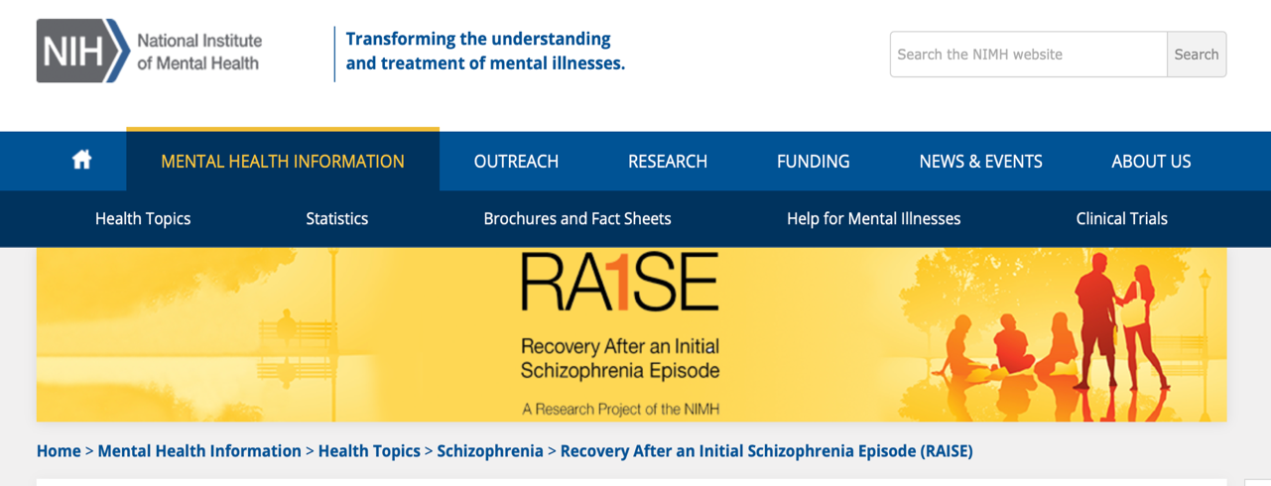
RAISE is a large-scale early psychosis research initiative that began with two studies that examined different aspects of coordinated specialty care (CSC). CSC is a team-based, multi-component approach to intervention for first episode psychosis.
https://www.nimh.nih.gov/health/topics/schizophrenia/raise/index.shtml

Slide 11
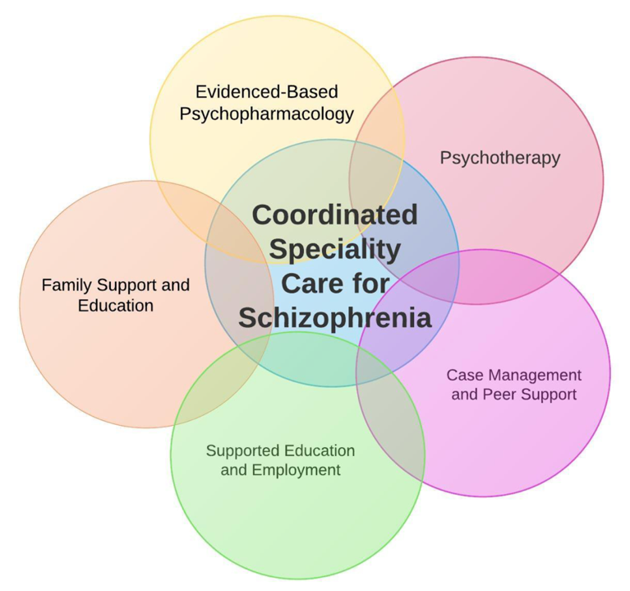
What is Coordinated Specialty Care?
CSC: Multi-component approach to intervention for first episode psychosis.
Credit: John Torros https://twitter.com/johntorousmd/status/799296074267627520

Slide 12
Evidence for Coordinated specialty care (CSC)
In 2008, the National Institute of Mental Health (NIMH) launched the Recovery After an Initial Schizophrenia Episode (RAISE) Project. RAISE is a large-scale early psychosis research initiative that began with two studies that examined different aspects of coordinated specialty care (CSC).
  The RAISE Early Treatment Program (RAISE-ETP) was a multi-site randomized controlled trial that compared the effectiveness of CSC programs to typical care delivered in community treatment settings.
  The RAISE Implementation and Evaluation Study (RAISE-IES) evaluated CSC implementation in publicly-funded community clinics, and developed staff training and program operations materials to support dissemination and implementation in other settings.
Found better outcome from CSC for
Symptoms
Work/Education
Social Lives

Slide 13
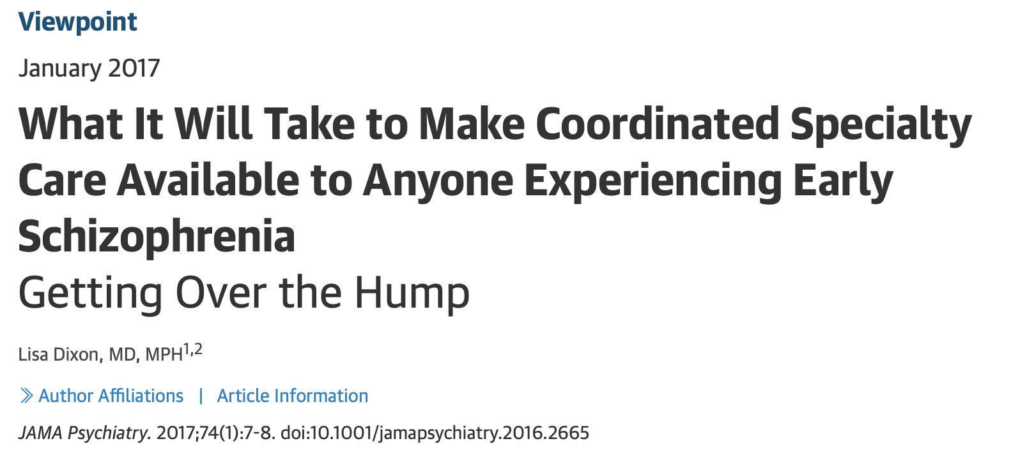

Slide 14
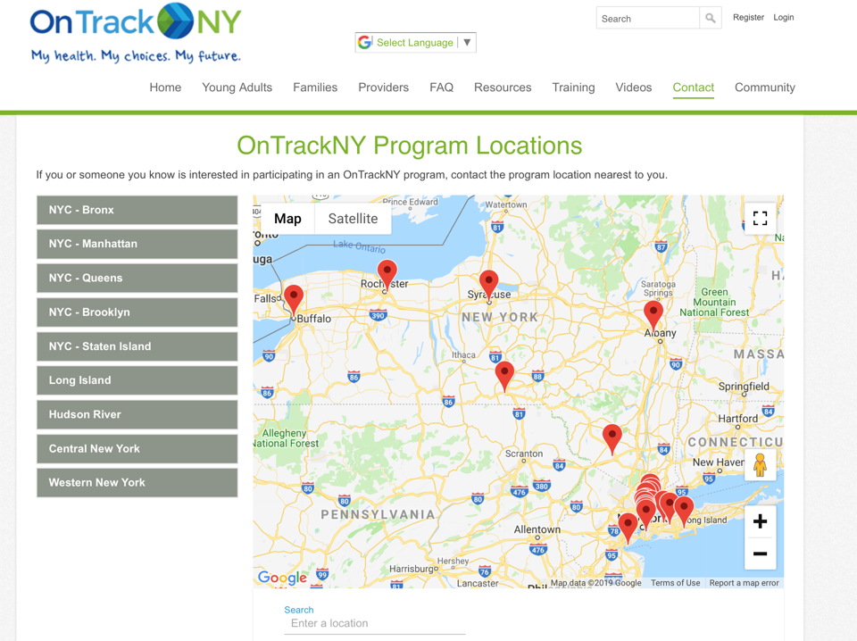
What is OnTrackNY?
Implementation of CSC for FEP across NY supported by
NYS-OMH
21 sites state-wide

Slide 15
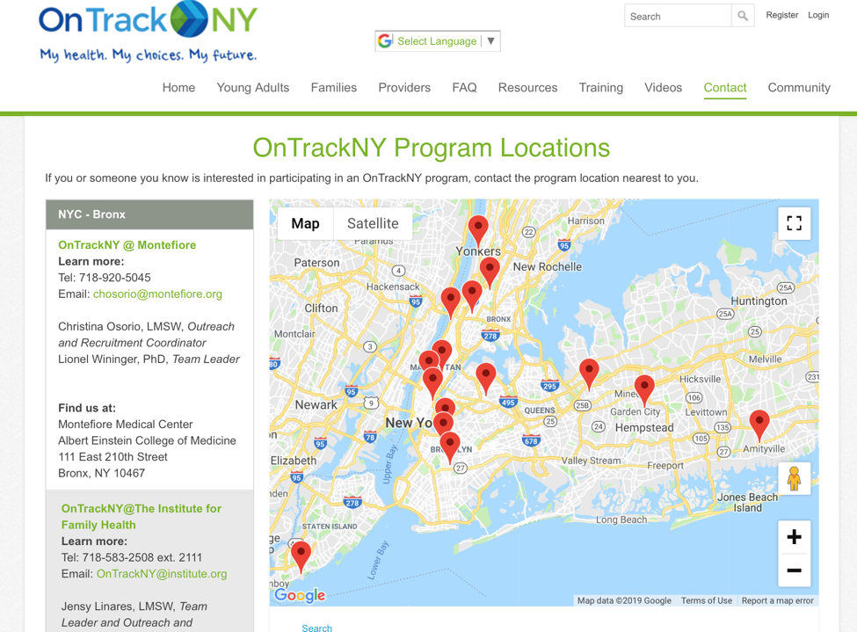
15 in the NYC/Long Island area

Slide 16
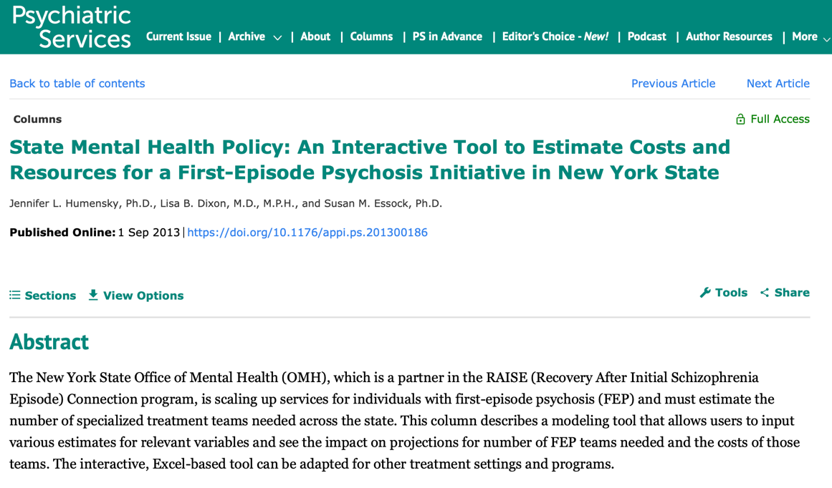

Slide 17
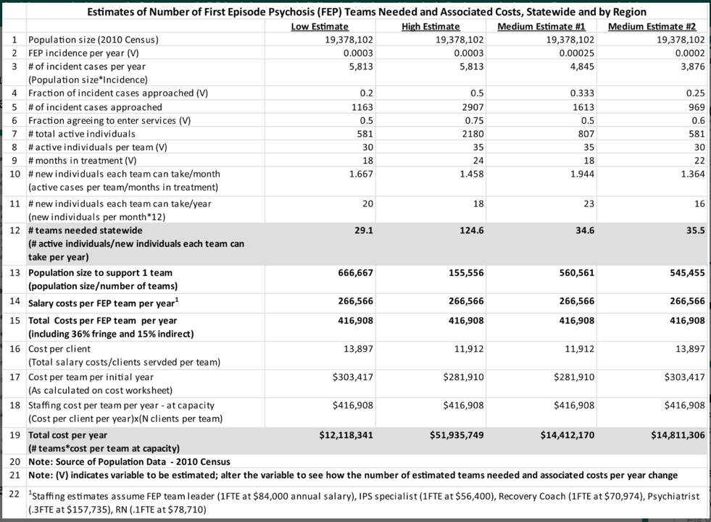
Analytic tools have been an active feature of the OnTrackNY program since its initial roll out
Calculator for policy makers to estimate costs/capacity for new FEP specialty treatment teams
Humensky et al 2013 Psych Services

Slide 18
OnTrackNY Data Collection
21 current sites in 2019 - Expected annual new enrollment of about 420 individuals across the state (about 7% of new FEP in the state)
OnTrackNY sites are contractually obligated to participate in the data collection and continuous quality improvement activities of the learning healthcare system.
Client Characteristics
at Intake
-Demographic
-Psych and med hx
-Life Functioning
OnTrackNY Coordinated Specialty Care
Post Discharge Client Outcomes
-Short and long term
-Service use
-Employment
-Education
-Quality of life
Pathway to Care
Outcomes Monitoring
Discharge
Tx Processes
-Services provided
-Fidelity of services
-Services used
-Psych/med functioning
-Life functioning

Slide 19

What is a learning health system?
Learning health systems (LHS) merge healthcare delivery with research, data science, and quality improvement processes.
The LHS cycle begins and ends with the clinician-patient interaction, and aspires to provide continuous improvements in quality, outcomes, and health care efficiency.

Slide 20
What can data science do here?
Client Characteristics
at Intake
-Demographic
-Psych and med hx
-Life Functioning
OnTrackNY Coordinated Specialty Care
Post Discharge Client Outcomes
-Short and long term
-Service use
-Employment
-Education
-Quality of life
Pathway to Care
Outcomes Monitoring
Discharge
Tx Processes
-Services provided
-Fidelity of services
-Services used
-Psych/med functioning
-Life functioning
Data is being collected/wrangled at each step
Data Science is the Engine for Learning Health System

Slide 21

Big Data Streams
Vision of a Learning Health System:
Want to collect data and use predictive analytics that are actionable by aiding clinical practice in real-world settings to improve mental health
Clinical Symptoms
Brain imaging – PET, fMRI, MRI, DTI, EEG
Neurocognitive tasks – sensory processing, cognition, motivation
Predictive Analytics
(Machine learning)
Recommend Action
(e.g. start treatment)
Mobile phone
Active sensing: Behavior/mood with EMA
Passive sensing: actigraphy, GPS, communication logs, sleep logs
Natural language processing of speech and/or of texts
Electronic Health Record history
Biological data: Genomic data, inflammatory markers
Monitor action with additional collection of integrated data

Slide 22
Supervised Learning Algorithms
Many predictive modeling algorithms readily implementable in software packages
Tree-based
Ensemble Methods
Bagging, Boosting Random Forest
Penalized regression methods –
LASSO/Elastic NET
Classifiers
Discriminant Analysis
Support Vector Machine
Artificial Neural Networks
Deep Learning

Slide 23
Machine learning has entered as a useful tool for prediction in the presence of Big Data
Big Data in Psychiatry
Clinical Symptoms
Big Data
Volume
Scale of data
Velocity
Analysis of streaming data
Variety
Different forms of data
Veracity
Uncertainty of data
Brain imaging – PET, fMRI, MRI, MRS, DTI, EEG
Neurocognitive tasks – sensory processing, cognition, motivation
Wearable devices
Active/Passive sensing:
Natural language processing of speech and/or of texts
Electronic Health Record
Life Experience social, cultural, environmental
Biological data: Genomic data, inflammatory markers
.
.
.
4 V’s of big data adapted from 3 V’s attribution Doug Laney 2001 Meta group 3D data management: Controlling data Volume, Velocity, and Variety.

Slide 24
3 problems with current state of predictive modeling in health applications
Flexible prediction function tends to have high accuracy in training data – needs careful tuning to work well in testing data
True predictive performance much lower than hyped expectations. Statistical significance found in explanatory models does not imply good prediction
“Black box” predictors, with no automatic variable selection interpretation still difficult

Slide 25
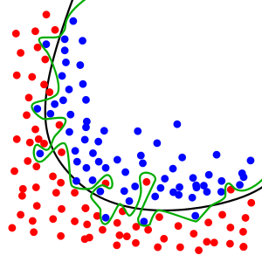
Problem #1 Overfitting is potentially a big problem
The model may predict the current data set very well, but may not generalize to the population
For a given data set
Complex model → may overfit the data
Simple model → may underfit the data
How to find a good prediction model?
Prediction should be judged by ability to generalize to new situations

Slide 26
How badly inflated is the in-sample predictive accuracy?
Pretty bad.

Slide 27
Training, Cross-validation, and Testing for Supervised ML Prediction models
Test data
Training and validation data
Training Stage: use training and validation data – 5-fold cross-validation is a subset of the training data
“Best” model found based on minimizing
cross-validation prediction error
Input X
Iteratively find “best” machine learning model
Correct Y
Testing Stage: uses model from training stage and test data
Input X
ML Model found during Training/validation
Best Guess for Y
Measures of true “out of sample” prediction accuracy
Correct Y

Slide 28
Problems with cross-validation – and solutions
Leakage of Test Data
  Leakage of information from the test data into the cross-validation (e.g. variable selection by some kind of thresholding of correlations using the entire data set)
Solution
Include all processing operations within the cross-validation loop
Use a true held-out test set
Pre-registration of analysis plans (center for open science)
Nonindependence between training and Testing
  systematic relationships between observations. (e.g. clustered samples, data from families)
Solution
Solution leave k families (clinics) out rather than individuals

Slide 29
Problem #2 Statistical significance in explanatory models does not imply good prediction
“It’s hard to make predictions … especially about the future” Yogi Berra
Our intuition is wrong:
Prediction is not necessarily going to be easier in areas where we have previously identified risk factors
Group mean differences (even pretty large ones) do not translate into good predictive performance

Slide 30
From Abi-Dargham and Horga (2016) Nature Medicine Search for imaging biomarkers in psychiatric disorders
Typical “large” effect sizes on a biomarker does not mean good predictive value… unless the effect sizes are VERY large
For a disorder with prevalence 5%, we need group difference effect size = 4 to get 80% PPV.
Notes:
With 1% prevalnce need Cohen’s d of 5 before hitting 50% Positive predictive value

Slide 31
Problem #3 Interpretations
In Health care, tradeoff between model complexity and interpretability depends on application.
A clinical treatment may require interpretable models to increase credibility, other applications may pursue the best prediction performance regardless of model interpretability and, in this case, treating the model as a black box is fine.
Data not often not well harmonized, measures often depends on “human judgement”
Regulatory (i.e. privacy, ethics, etc.)
Progress is being made using visualizations

Slide 32
Things to consider with predictive modeling for learning health care system
Generalizability - Depends on data used to train/test, does it look like the population it will be used with in the future?
Feasibility – Will all the needed features be available when doing predictions in the future? Will they be measured in the same way?
Action/Deployment – How will the predictions be used in the future? Interface, support, update

Slide 33
An initial test case –
Estimate the likelihood that a specific person entering OTNY will have “good” social/occupational functioning across the first year of treatment
Such a prediction tool could improve treatment by informing clinical decision-making before the commencement of treatment
We want to test whether such a tool could be successfully built and validated using routinely available data.

Slide 34
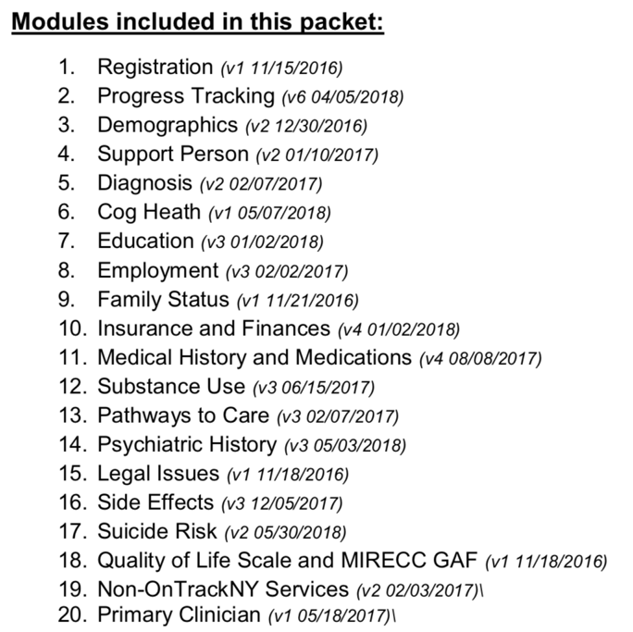
On Track Data Collection
Admission
and every 3 month followup

Slide 35
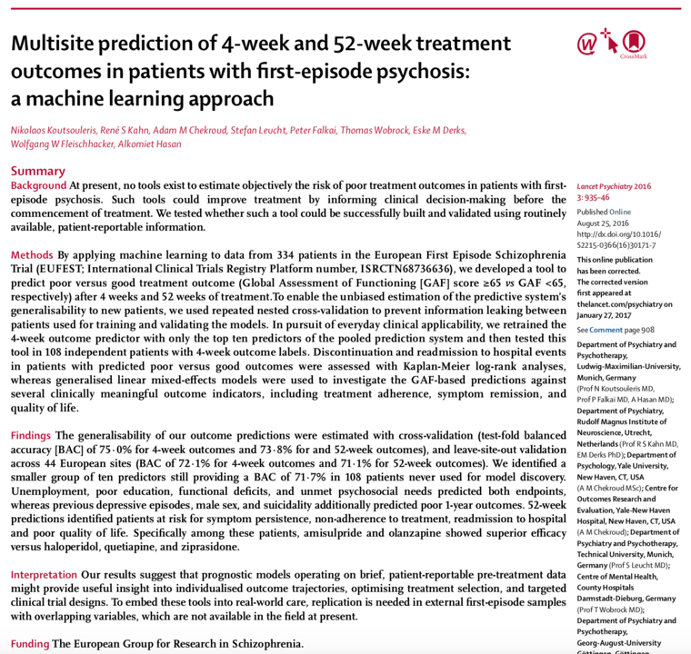
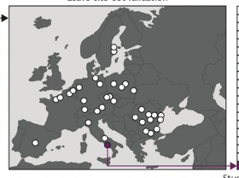
A group from Europe has some initial results
We try it on data from NY

Slide 36
Flow chart of patients enrolled in OnTrack during 1-year follow-up

Slide 37
Living Situation and family contact
Homeless | 37 | 5.8
Living with
Parents | 544 | 85.8
Other family (not parents) | 41 | 6.5
Alone | 23 | 3.6
Other | 26 | 4.1
Family Contact
Daily | 568 | 90.4
Weekly | 42 | 6.7
Monthly or less | 18 | 2.9
Clinical variables
Time to first service use (days) | 565 | 61.7 (133.4)
Time to OnTrackNY (days) | 634 | 230.0 (186.7)
Primary Diagnosis
Schizophrenia (295.90) | 188 | 29.7
Schizoaffective (295.70) | 94 | 14.8
Schizophreniform (295.40) | 143 | 22.6
Other (delusional dis, schiz spectrum, other psychotic dis) | 209 | 33.0
Any Substance use (including Tobacco) | 316 | 49.8
 | Overall (N=634)
 | N | % or M (SD)
Demographics at enrollment
Female gender | 165 | 26.0
Age at enrollment | 634 | 20.9 (3.2)
Race^{b}
White (Non-Hispanic) | 169 | 26.7
Black (Non-Hispanic) | 218 | 34.4
Hispanic | 181 | 28.5
Other | 66 | 10.4
Highest Education
<HS | 182 | 28.7
HS or GED | 119 | 18.8
Some College | 333 | 52.5
Employed or in school | 258 | 40.7
Insurance status^{b}
Uninsured | 20 | 3.2
Public | 286 | 45.1
Private | 267 | 42.1
Highly urban site | 381 | 60.1

Slide 38
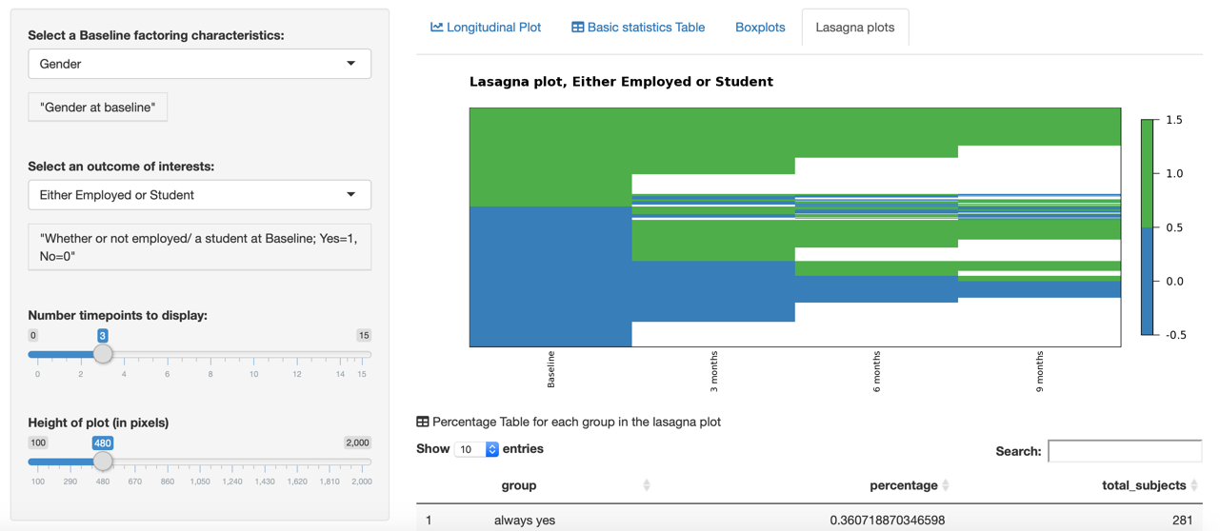
Outcome of interest: normative school and/or work trajectories (either working or a student) at follow-up visit

Slide 39
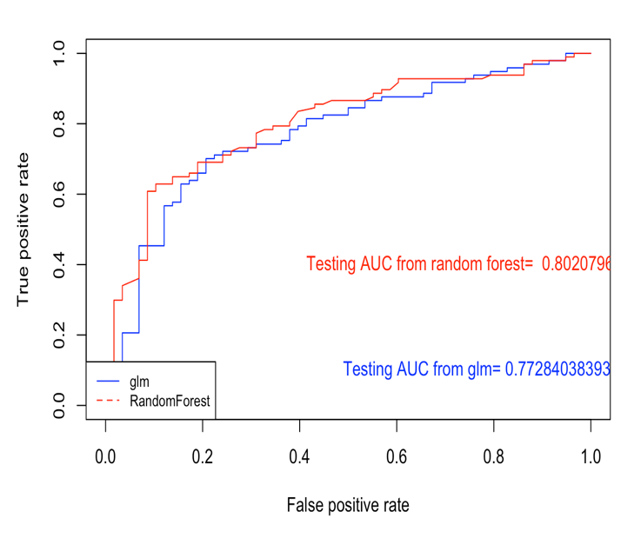
Predicting whether the person is working or in school at first followup visit (3-month)
N=634
p=30
Similar performance with p=200 and similar performance with Super learner combining across 8 algorithms

Slide 40
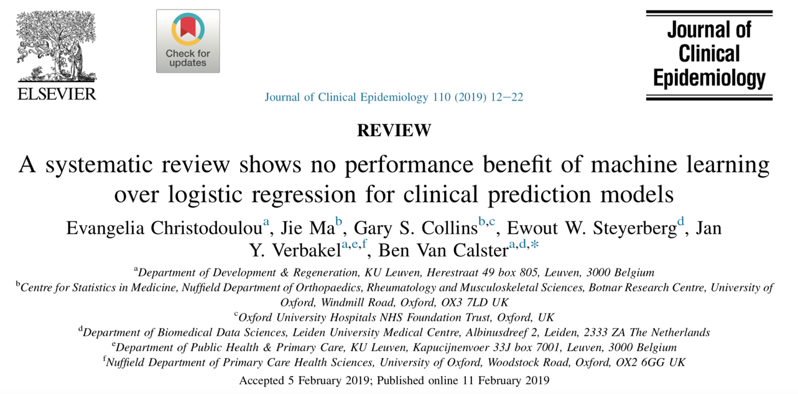

Slide 41
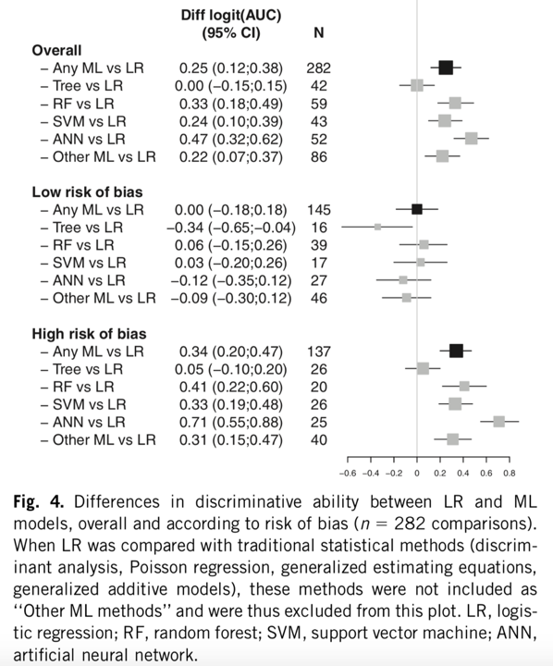
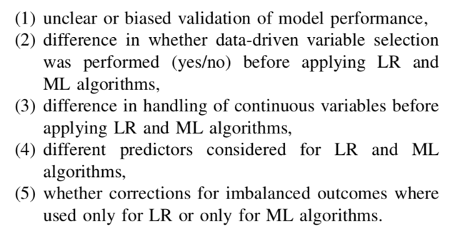
Operationalization of “risk of bias” any one of the following

Slide 42
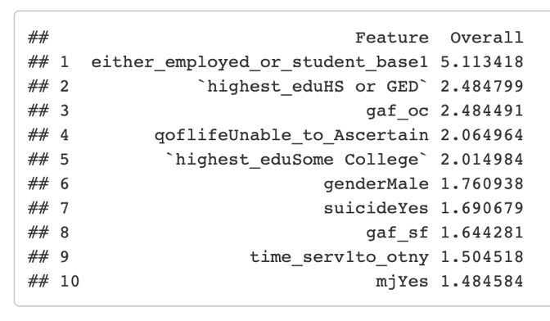
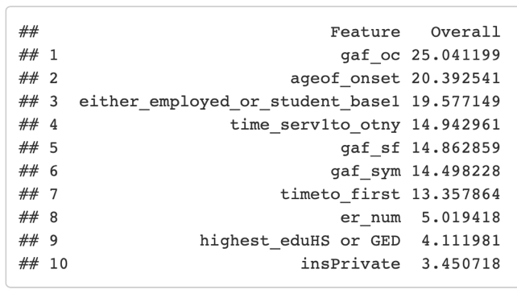
Looking for interpretations
<-Logistic
Random forest ->

Slide 43
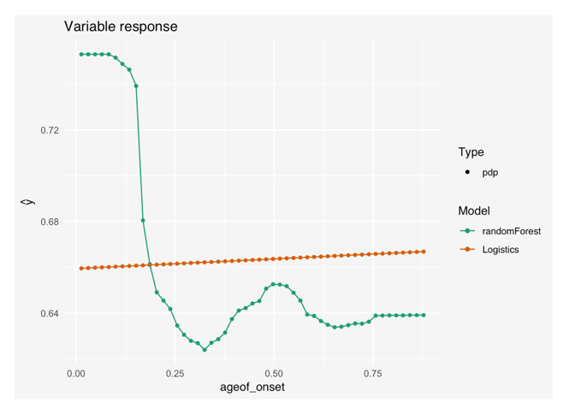
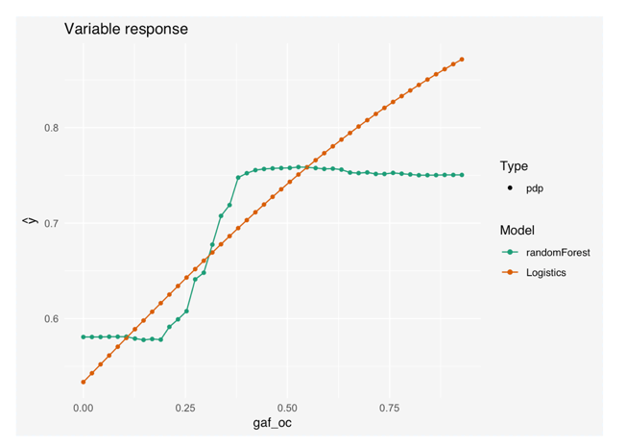
Random forest finds some nonlinearities

Slide 44
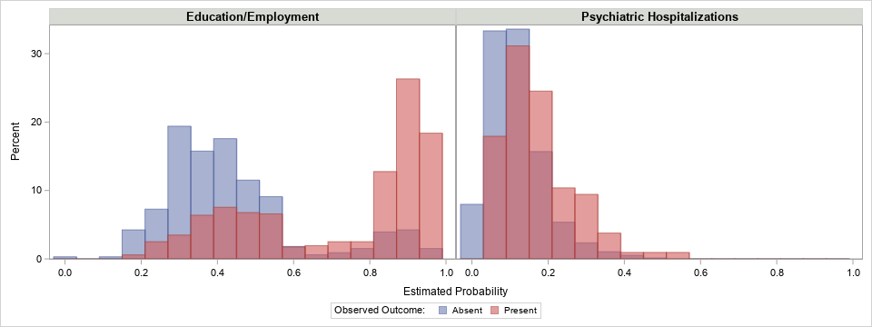
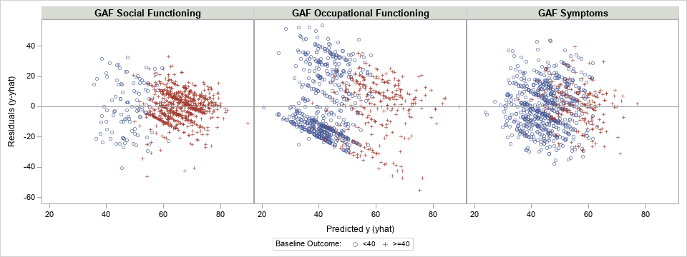
Comparing predictive performance for different outcomes at 3-months
Binary
  Education/Employment: AUC = 0.80
  Hospitalization:
  AUC = 0.69
Continuous – GAF functioning scores (0-100)
  Social functioning:
    R-square = 0.39,
    mean ABS residual = 8.0
  Occupational functioning:
    R-square = 0.24,
    mean ABS residual = 17.3
  Symptom functioning:
    R-square = 0.26,
    mean ABS residual = 11.7

Slide 45
Still to be done – questions of deployment
How good should prediction be before recommending taking different action?
What is best way to provide information to clinician, to patient? Visualizations
How often should prediction models be updated (data streams)?

Slide 47
Final Thoughts
Mental Health Services and OTNY has embraced the idea of a Data Driven Learning Health Systems
Let’s look for more ways to bring together CU Department of Biomedical Informatics with NYSPI Mental Health Data Science
Contact: Melanie Wall at mmwall@columbia.edu

